Slide 1
LECTURE 7
Conflict Management

Slide 2
What is conflict?
A battle, contest or opposing forces existing between primitive desires and moral, religious or ethical ideas ( Webster’s Dictionary)
A state of incompatibility of ideas between two or more parties or individuals
Conflict management is the practice of identifying and handling conflict in a sensible, fair and efficient manner

Slide 3
CONFLICT HAPPENS
Conflict is…
a normal, inescapable part of life
a periodic occurrence in any relationship
an opportunity to understand opposing preferences and values
ENERGY

Slide 4
Conflict Management
The term conflict management is sometimes used interchangeably with conflict resolution. The difference, however, is that the concept of conflict management is based on a premise that not all disputes end in resolution.
Additionally, conflict management is the practice of identifying and handling conflict in a sensible, fair, and efficient manner. Conflict management is any collection of actions, responses, processes, and/or systems that help manage, improve, or prevent the deterioration of relationship dynamics.
When the parties can not resolve the dispute, they use strategies to manage the dispute and acknowledge their differences. Conflict management makes the parties to a dispute aware of their options. It allows them to examine their own assessments, to communicate their feelings and assessments, and to choose options that avoid defensive reactions

Slide 5
Conflict Management
Sources of Conflict
Value Conflict
Data Conflict
Interest Conflict
Structural Conflict

Slide 6
Types of conflict
Inter-personal and intra-personal
Inter-group and intra-group
Competitive and Disruptive

Slide 7
Conditions
Scarce Resources
Conflicting attitude
Ambiguous jurisdiction
Communication barriers
Need for consensus
Unresolved prior conflicts
Knowledge of self and others

Slide 8
How to create conflict?
Not being a role model
Take credit, no recognition
Be judgmental
Send written messages
Subordinate should come to see me
Make yourself inaccessible to your team
Individual Vs team approach
Telling them? Consulting them? Or deciding with them?
Come tomorrow
Introduce change without consultation or discussion

Slide 9
Effects of conflict in organizations
Stress
Absenteeism
Staff turnover
De-motivation
Non-productivity

Slide 10
Tools for Conflict Management

Slide 11
BLAME
What doesn’t
work

Slide 12
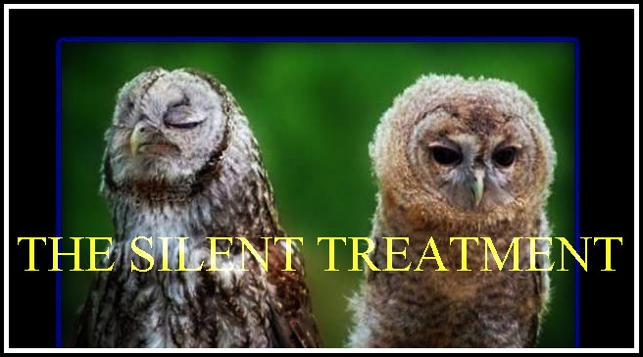
You get the picture…
What doesn’t
work

Slide 13
The “third party”
What does
work

Slide 14
Contribution Mapping
What does
work

Slide 15
5 ways to manage conflict
Avoidance
Accommodation (B)
Compromise (C)
Collaboration (D)
Force
Notes:
First, write A,B, C, D in a column on the board; tell students you want to know where their scores fell and would like them to raise their hands to show where their highest score occurred as you read out each letter. Total the number of hands raised on each and provide a number so all can see where styles are clustered.
There are five ways of managing conflict, and each has its place.
First, (and not measured on this questionnaire) is to manage conflict by avoiding it. And there are many instances when a manager might chose to avoid conflict. For example, if the conflict is a flare-up between volatile persons who will soon forget the conflict, there is no point for the manager to get involved. Similarly, if the conflict is unimportant it may also be prudent to avoid it. The point is, sometimes avoidance is a good policy. (Sometimes in my family life, I will avoid a conflict if it appears that my spouse is tired or grouchy, for example.)
Often conflict cannot be avoided at which point we engage. Most people tend to have a preferred style of conflict management, and those are the preferences you showed by scoring highest on A, or B or C or D. So we see that in this class, we have many people who are (fill in the blank).

Slide 16
Conflict Management
Smooth/ Accommodate
Compromise/ Reconcile
Force/ Direct
Collaborate/ Problem Solve
Withdraw / Avoid
Retreating from an actual or potential conflict situation; postponing the issue to be better prepared or to be resolved by others.
Emphasizing areas of agreement rather than areas of difference; conceding one’s position to the needs of others to maintain harmony and relationships.
Searching for solutions that bring some degree of satisfaction to all parties in order to temporarily or partially resolve the conflict.
Pushing one’s viewpoint at the expense of others; offering only win-lose situations, usually enforced through a power position to resolve an emergency.
Incorporating multiple viewpoints and insights from differing perspectives; requires a cooperative attitude and open dialogue that typically leads to consensus and commitment.

Slide 17
Conflict Continuum
I win, you lose (competition—A)
I lose or give in (accommodate—B)
We both get something (compromise—C)
We both “win”(collaborate—D)
A B C D
Notes:
First, let’s think about conflict as it unfolds for you. Think about one example (personal or professional) of when you used a particular style and tell us how that position worked for you.
Here are pluses and minuses for each style:

Slide 18
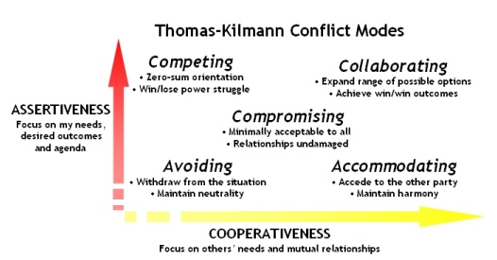
Conflict Management
It is used when outcome is more important than relationship, e.g., in emergencies. This also involves assertiveness but not cooperation.
Can mean running away but evasion or delay can be appropriate and constructive. This approach can be useful in highly emotional situations where time is needed to gain perspective.
Both sides agreeing to make small or superficial concessions. Both parties make concession and bargaining to and reach a settlement to which both agree.
Cooperation wherein one side agrees to other's wants. Usually occurs when the outcome of the situation is very important to one person but less so to the other.
Meeting underlying needs of both parties. It allows assertiveness and cooperation in the search for a solution that meets the needs of all.

Slide 19
How to create conflict?
Not being a role model
Take credit, no recognition
Be judgmental
Send written messages
Subordinate should come to see me
Make yourself inaccessible to your team
Individual Vs team approach
Telling them? Consulting them? Or deciding with them?
Come tomorrow
Introduce change without consultation or discussion

Slide 20
Conflicts Reasons
Schedule
Priorities
Recourses
Technical opinion
Admn Procedures
Cost
Personality

